Slide 1


Patient-based Real Time Quality Control using Unsupervised LSTM
14375253 Zi En Tham

Slide 2
Background
To monitor the accuracy and precision of test results
Continuously evaluates the quality of test results in real-time by comparing them to expected values for each individual patient
Traditionally, PBRTQC uses some of the variants of Average of Normal (a type of statistical technique)
This study attempts to leverage machine learning technique on such task as proof of concept

Slide 3
The Concept of Unsupervised LSTM
What is LSTM?
A type of Recurrent Neural Network
Applies the learned information to develop a prediction
Capture long-range dependencies and retain information over extended time steps
Suitable for time series and sequence data
Why and How Unsupervised Approach?
Data are often unlabelled, hard to determine which is anomalous in real life
LSTM will attempt to learn what a "normal" pattern looks like
LSTM will then reconstruct it
If the reconstructed and the actual value differs too much, it will mark as anomalous
Supervised learning will make LSTM to learn which data is anomalous, in unsupervised, LSTM will not know which data is anomalous

Slide 4
Methodology
Moving Average
LSTM without Moving Average as Preprocessing
LSTM with Moving Average as Preprocessing

Slide 5
Datasets and Bias Simulation
Sodium and Creatinine have been selected due to their very different distribution (both are trained separately for each methodology)
For each dataset (sodium and creatinine), only the Day (based on 'Recorded') and Result are retained
80% training set, 20% test set
Bias Simulation (Shift Anomalies):
Biased is only introduced in the test set
For every 'Day', after the 300th Result, a bias is introduced for the rest of the 'Result' of that 'Day'
The rate is +-20%, +-10%, +-5% (6 different bias)

Slide 6
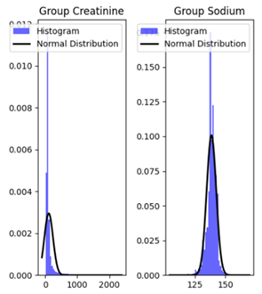


Slide 7
Data Preprocessing
Creatinine
Box-cox transformation
Min-max normalisation
Sodium
Min-max normalisation

Slide 8
Moving Average
Control Limit Calculation:
Symmetric CL
We find the standard deviation based on the mean of the training sets
We defined a threshold value and + - onto the standard deviation to form the upper and lower control limit
Finding anomalies:
Concat back the training and biased test set
Perform rolling mean of a fixed window size
Based on the rolling mean, any points that falls outside the control limit is counted as anomaly

Slide 9
Moving Average can smooth out the data, reducing the noise
What will be the effect of this if we applied in LSTM?

Slide 10
LSTM Without Moving Average
Sequences are constructed for both the training and test sets.
Each sequence represents a series of data points arranged in chronological order.
In this context, where data pertains to daily maintenance activities, sequences are organized to contain data points from the same day and avoid spanning into the next day.
In cases where the last sequence of a day extends into the subsequent day, the last sequence is disregarded, and a new sequence begins at the start of the next day.
Bigger sequence equals may have better generalisation, essentially finding the "golden line"
Train the LSTM using training sets (sodium and creatinine is trained separately)

Slide 11
LSTM With Moving Average
Perform rolling mean on training and test set separately
Create sequences
Will have same LSTM architecture for comparison purposes
Train the LSTM using training sets (sodium and creatinine is trained separately)

Slide 12
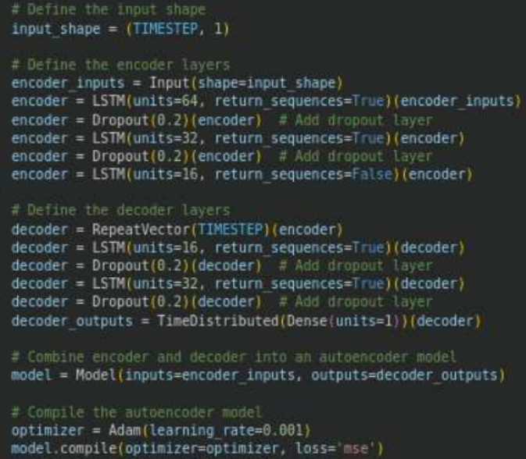
LSTM Architecture

Slide 13
Reconstruction Error
We calculate the mean square error loss (mse loss) between the reconstructed and the actual value
If the mse loss exceeded a predefined threshold, anomaly is found

Slide 14
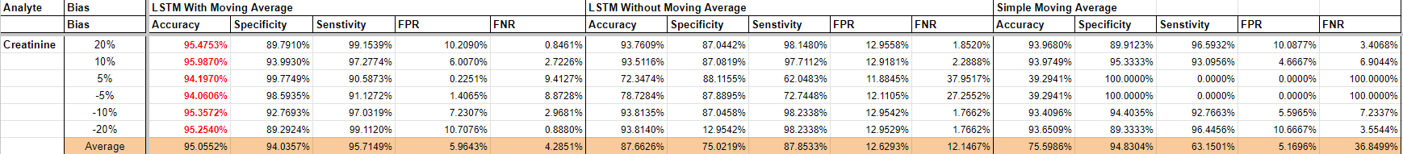
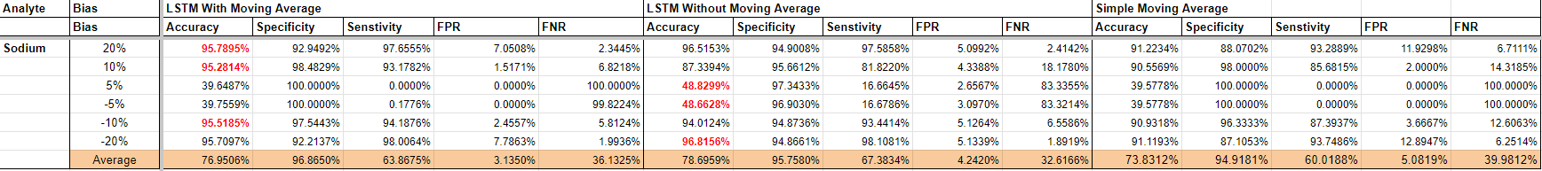
Results

Slide 15
The Final Model's Parameters
Threshold value for mse loss: 0.03 for all LSTM and analytes
Threshold value for control limit: 3 for both analytes
Size of sequence: 150 for creatinine, 70 for sodium
Moving Average window size for both LSTM: 50
Moving Average window size for MA experiment: 70 for sodium, 50 for creatinine

Slide 16
Findings
LSTM with Moving Average overall performs the best
High accuracy and overall FPR is below 6%
However, its performance is worst for sodium at +-5% bias
LSTM without Moving Average (average performance)
Moderately high accuracy
However, FPR is above 10% for creatinine on average
It has the highest accuracy for sodium at +- 5%
Simple Moving Average (average performance)
Moderately high accuracy, with FPR remains below 10% for both sodium and creatinine

Slide 17
Conclusion
LSTM with Moving Average can be deemed as successful in detecting anomalies for when there is a sudden shifts
Moving Average is good at smoothing out the noise, however, too much of it may cause a loss of information
This eliminates the need to calculate control limits
However, it is computationally intensive to run and require a lots of data to train
As seen with the 5% bias change, LSTM may not do well if the anomalies are slightly abnormal

Slide 18
Future Work?
More anomaly scenario such as gradual shifts
Different Average of Normal technique as baseline including exponential moving average, moving standard deviation...
Different types of analytes

